Slide 1
Color Palette Changes
December 2017

Slide 2
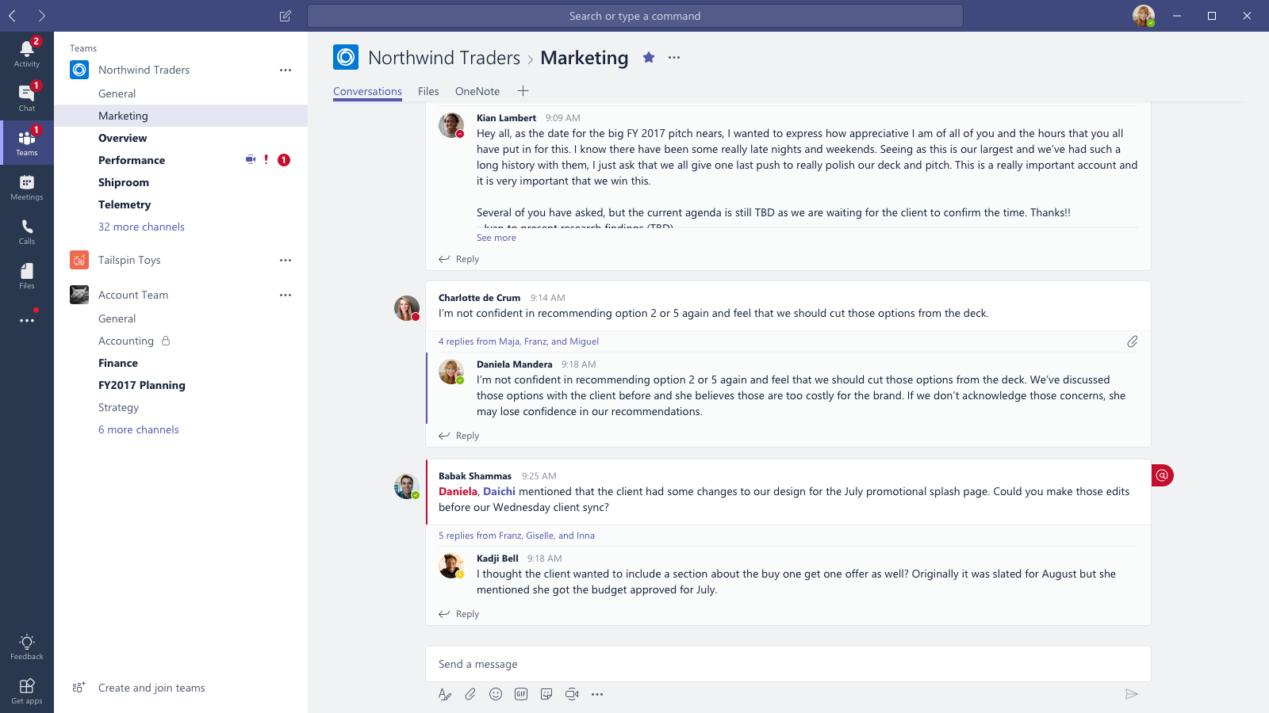
Light Theme / Old Colors

Slide 3
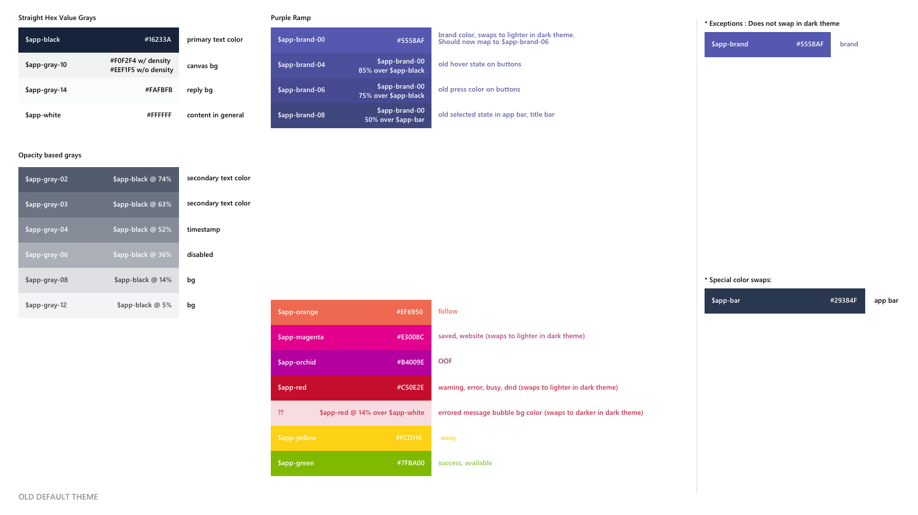

Slide 4
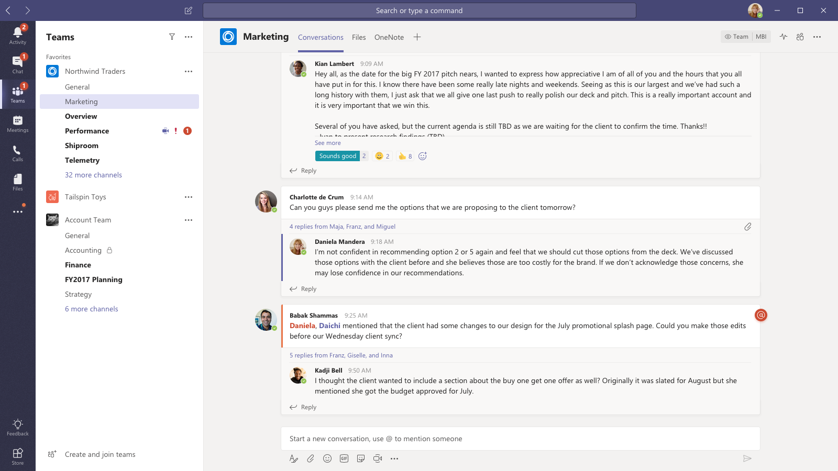
Light Theme / New Colors

Slide 5
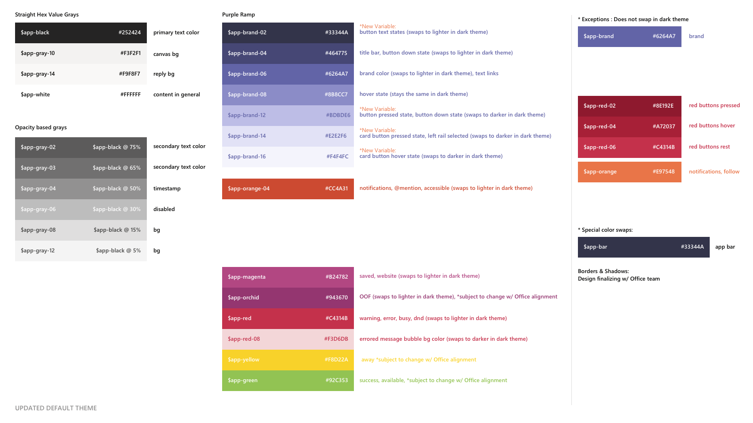

Slide 7
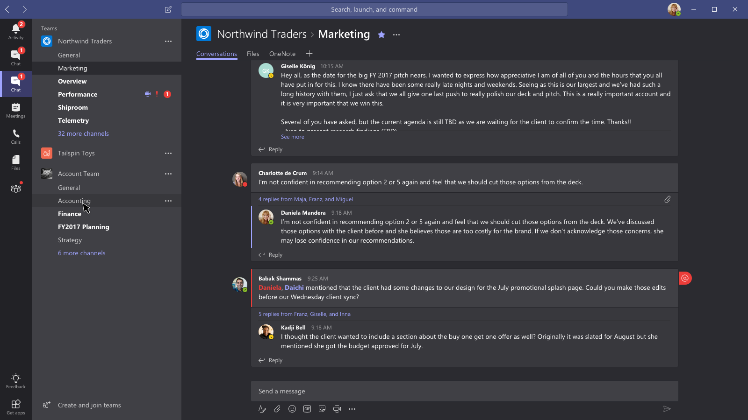
Dark Theme / Old Colors

Slide 8
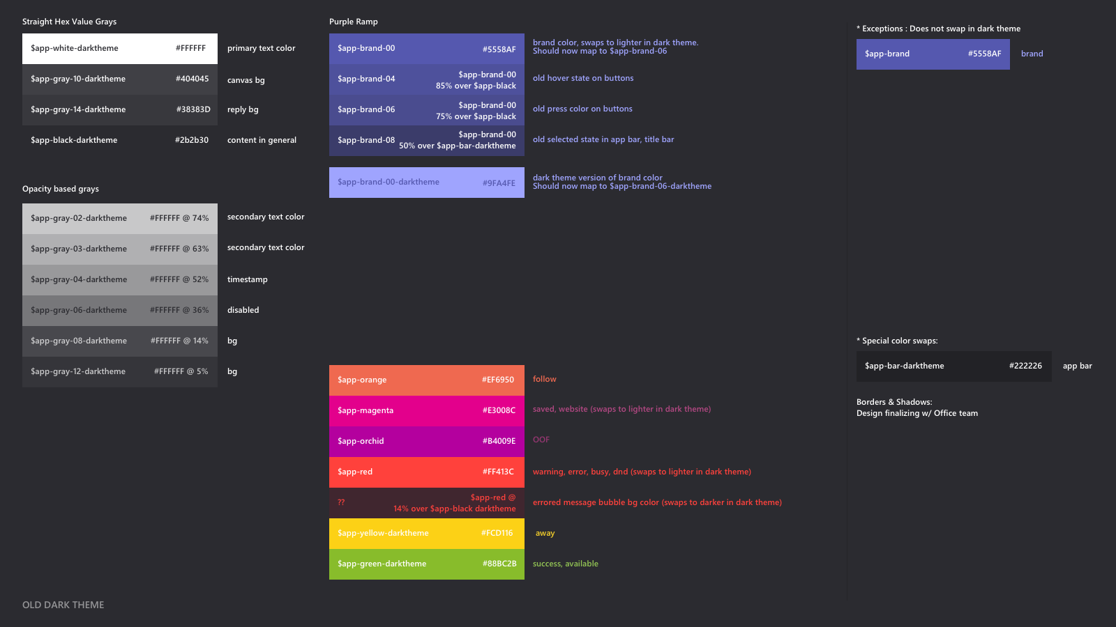

Slide 9
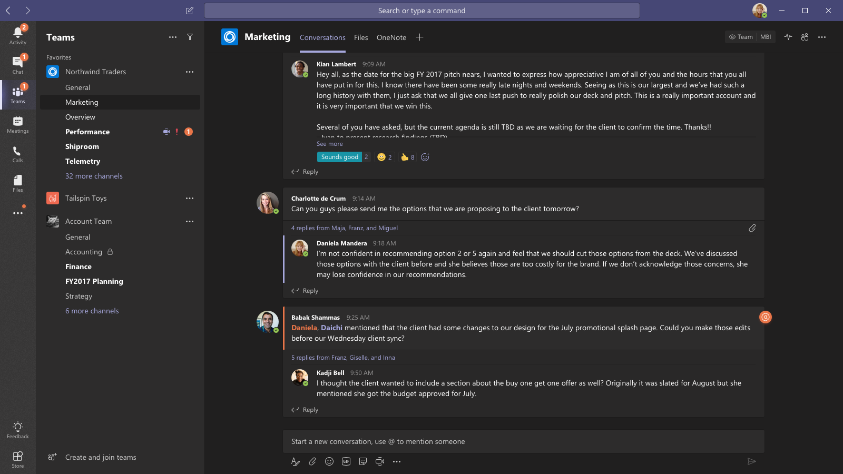
Dark Theme / New Colors

Slide 10
